Slide 1
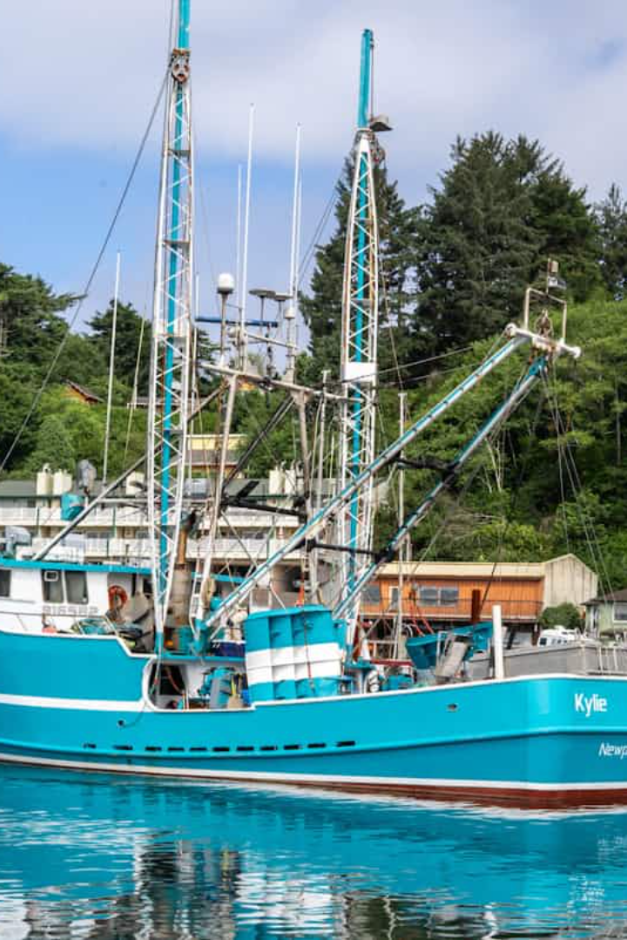


Otway Adjustment Protocol Claims Guide
The Otway Adjustment Protocol (OAP) provides a structured process for commercial fishers and marine operators to claim compensation when petroleum activities impact their operations. This guide walks you through the eligibility requirements and claim process.

Slide 2
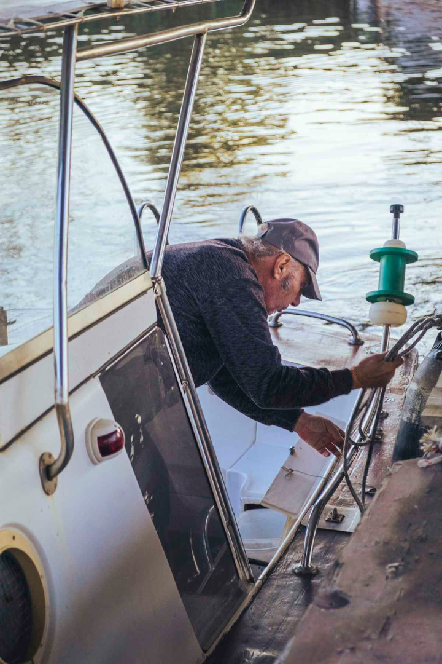



Determining Your Eligibility
Commercial Status
You must be a commercial fisher or marine operator who has been affected by one of the OMICC activities
Historical Activity
For loss of catch claims, demonstrate fishing history in the claimed area for at least 2 of the prior 5 years. Displacement claims require 5 years of operational history.
Demonstrable Impact
Show that you would have received revenue from landed catch, incurred additional costs from displacement, or suffered gear damage due to petroleum activities.

Slide 3






Types of Claims Available
Displacement
Relocation costs when moving operations due to petroleum activity
Loss-of-Catch
Compensation for reduced catch compared to previous years
Fishing Gear Loss/Damage
Reimbursement for gear damaged by petroleum activities
Each claim type requires specific documentation and has different eligibility criteria. Claims must be filed within 183 days (6 months) after the end of the petroleum activity. You're expected to mitigate losses where possible.

Slide 4
Preparing Your Claim Documentation
Complete Application Forms
Compile Evidence
Use the appropriate forms on titleholder’s online portal or from Appendices 2-5 of the protocol. Include clerical costs (up to $2,000) for claim preparation.
Gather Personal Information
Assemble documentation specific to your claim type: vessel tracks, fuel receipts, catch data, market prices, gear replacement quotes, or notification records.
Collect your name/company details, address, contact information, and relevant fishing licenses or authorizations.

Slide 5




Claim Assessment Process
Lodge Your Claim
Submit through the titleholder's online portal or via paper application within 6 months after petroleum activity ends.
Independent Assessment
A qualified assessor reviews your claim and prepares a report within 30 days.
Review Meeting
Discuss the assessment report with the titleholder to reach agreement.
Payment
Receive compensation within 30 days of agreement or independent expert decision.

Slide 6

Dispute Resolution Options
When can I request an independent expert review?
Who pays for the independent expert review?
Is the independent expert's decision final?

